Slide 2
Agenda
Learning Factory – Grant Richards
Common Safety Issues – Joseph Zaccaria
Workplace Safety using AI - Bala

Slide 4
AI For Good
How to apply vision AI for Health and Safety
Workplace safety use case for manufacturing/hospitals/construction/others
AI@edge
Adaptable AI at Edge

Slide 5
Why?
What if, you are hit with huge fine by government for a unintentional mistakes made by employee on missing some safety instructions.
How about launching program for employees following safety instructions wearing safety gear and brining Zero Incident plant.
Outcomes
Zero Incidents in plants
Avoid huge fines for unintentional mistakes

Slide 6
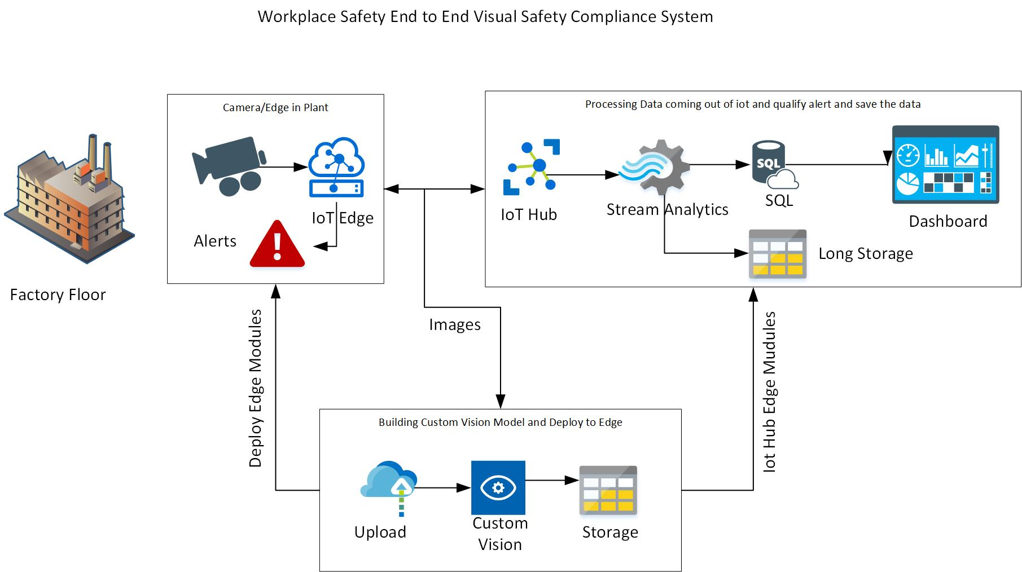

Slide 7
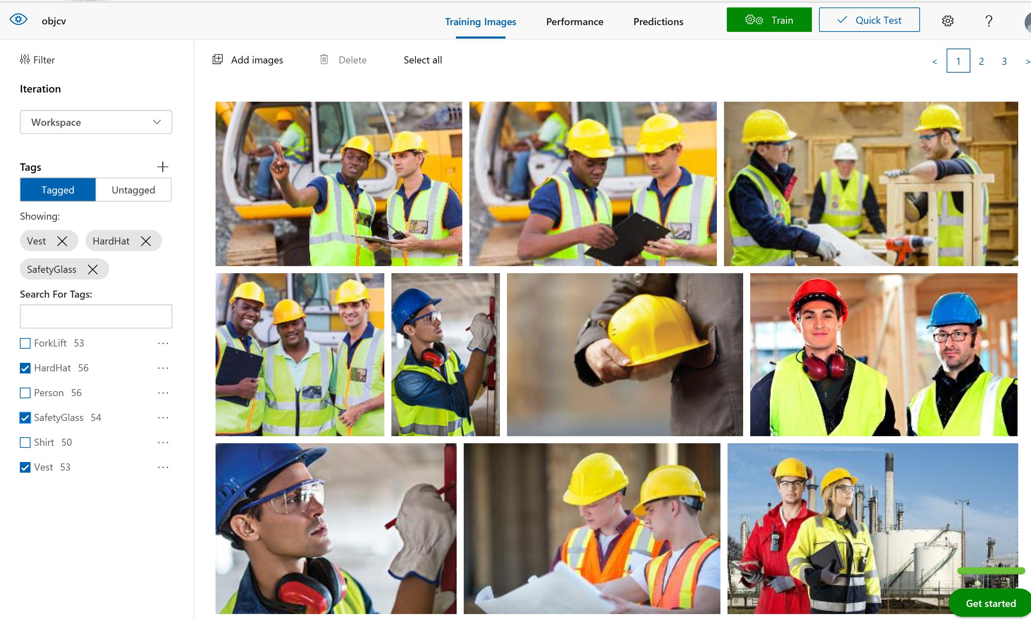
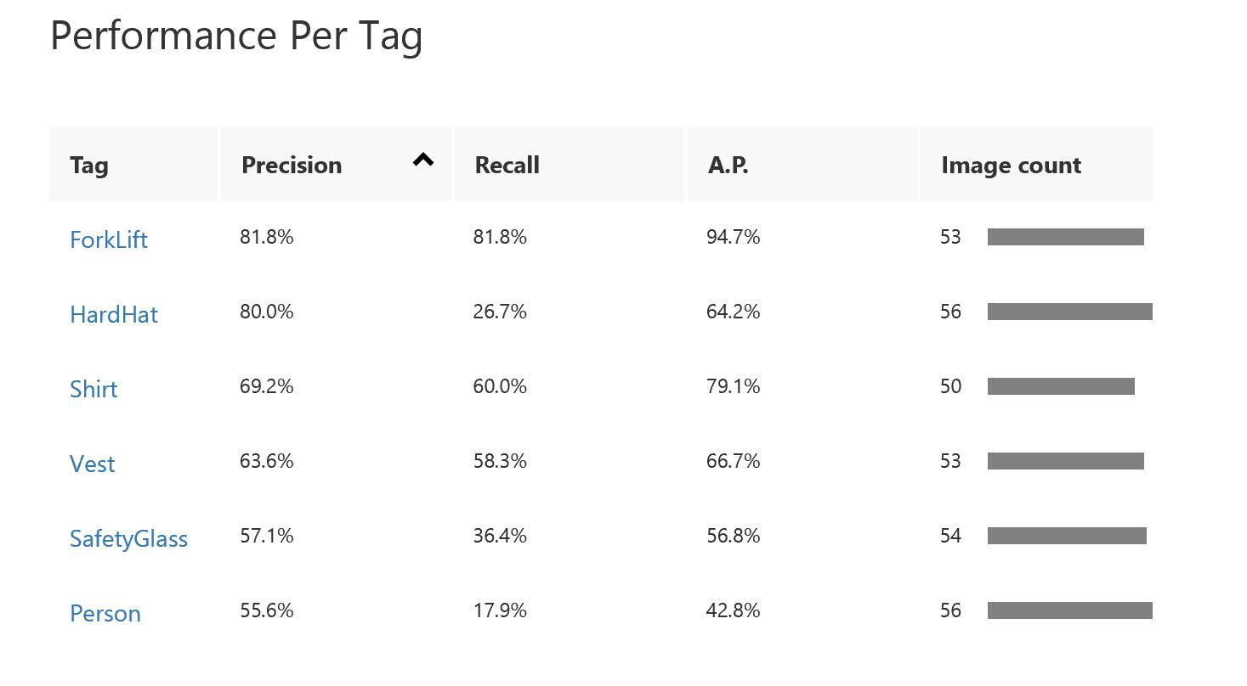
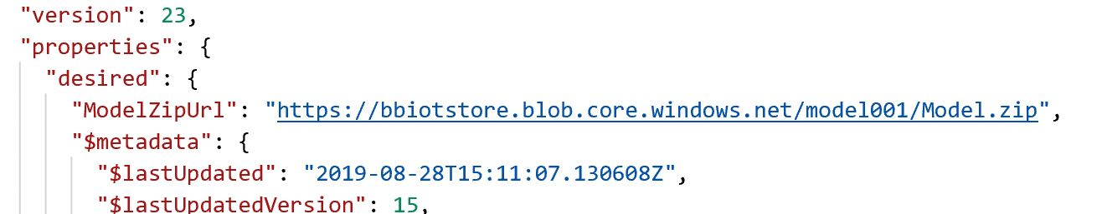
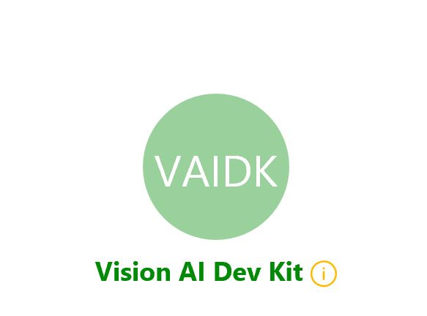
Custom Vision Model

Slide 8
Vision AI Dev Kit Demo

Slide 9
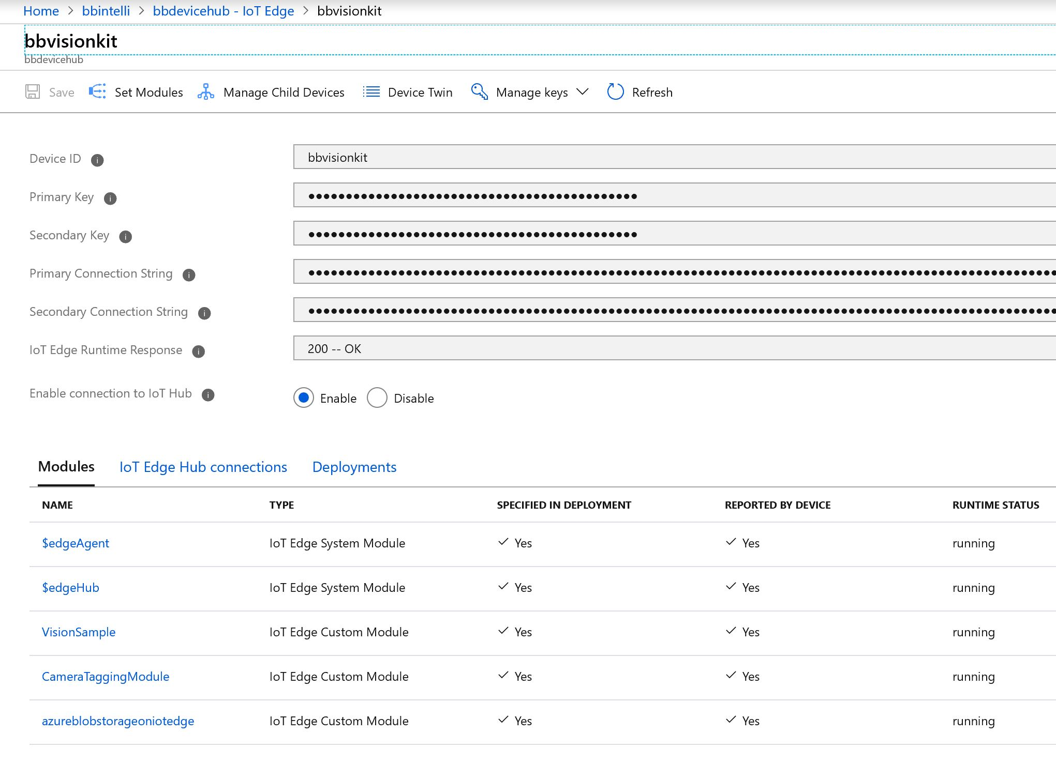
IoT Edge Modules Running in Vision AI Kit

Slide 10
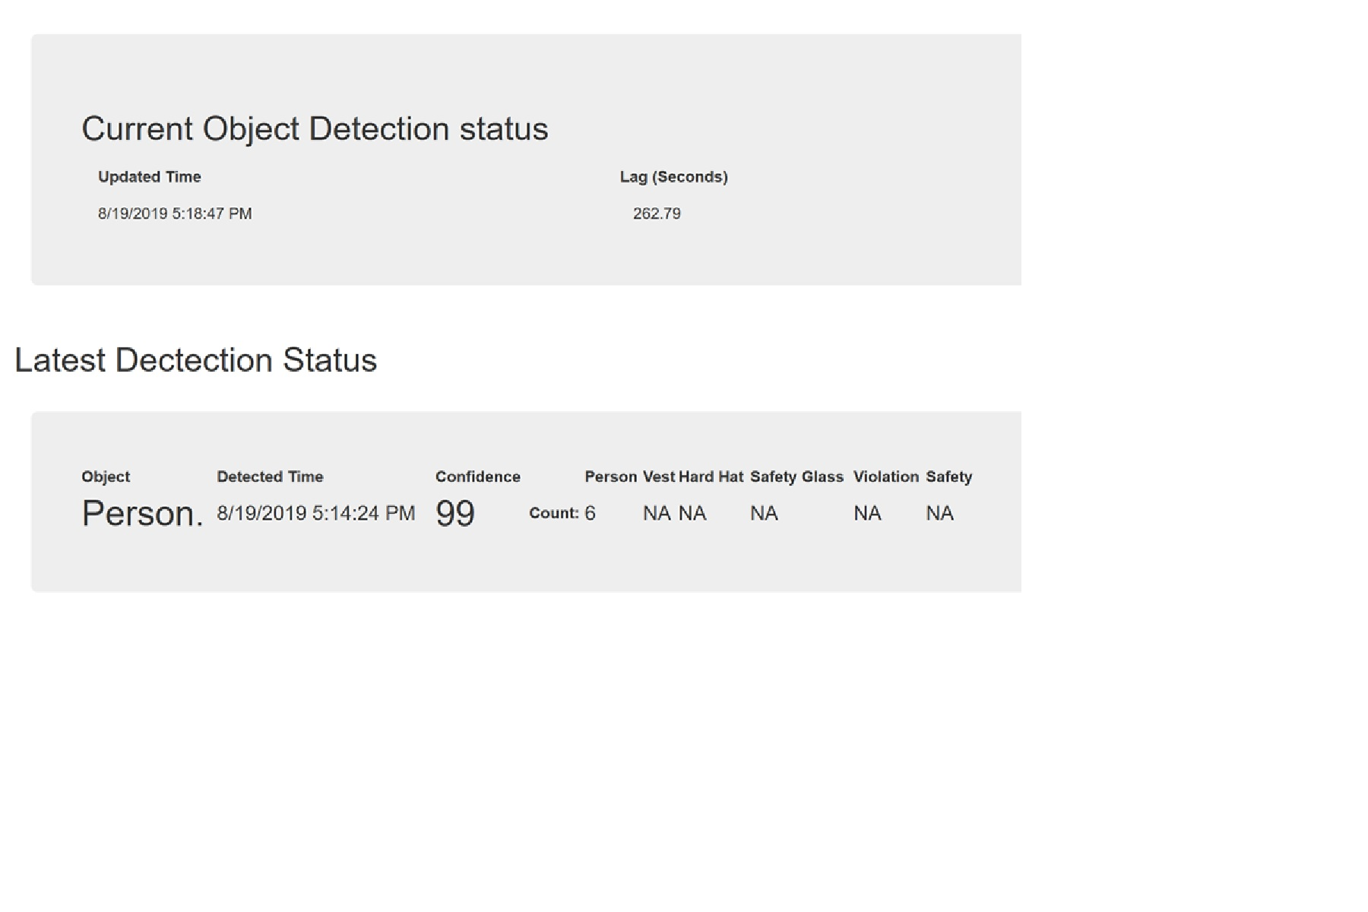
What Objects are detected?
The Top Box shows the latency between data received and processed.
The Second box shows the counts of objects detected and Violation count.

Slide 11
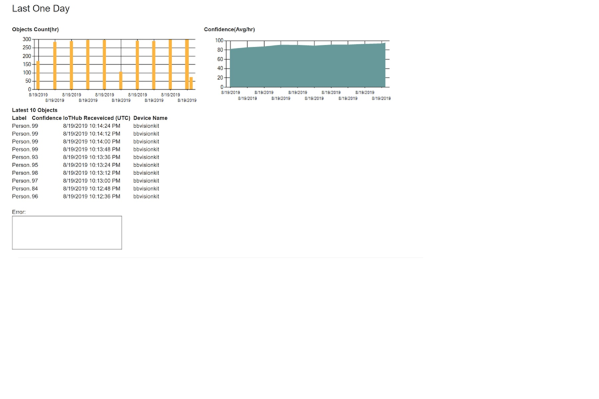
Watch Model Performance

Slide 12
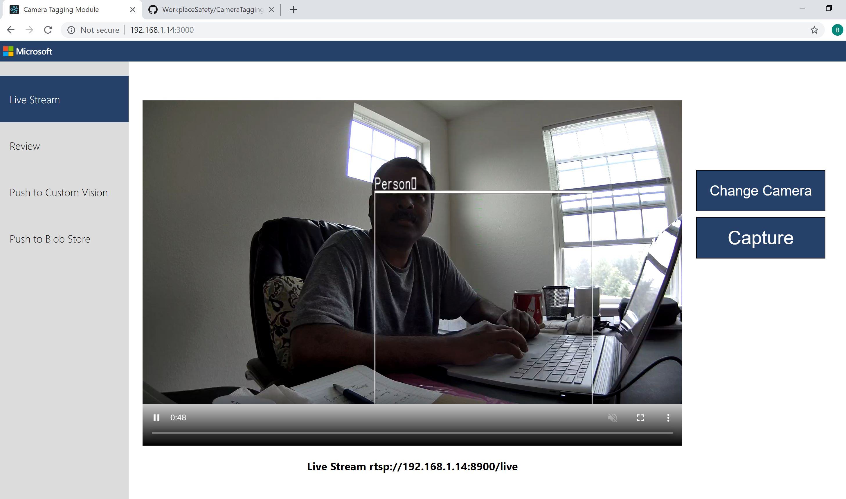
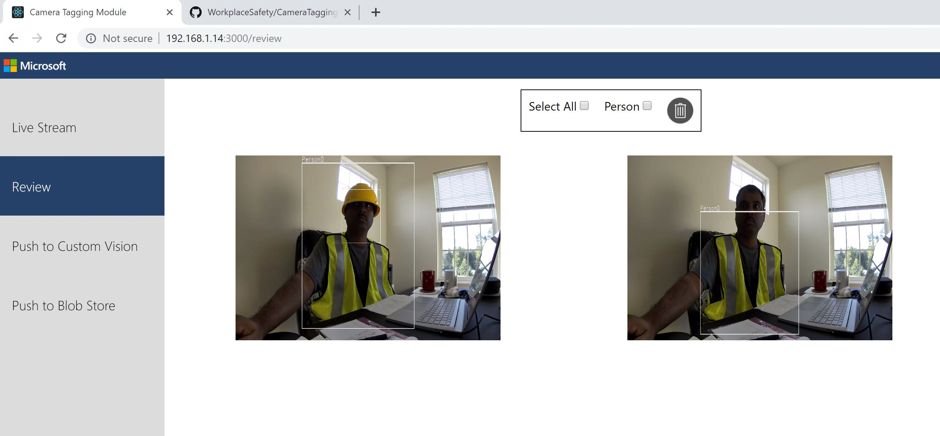
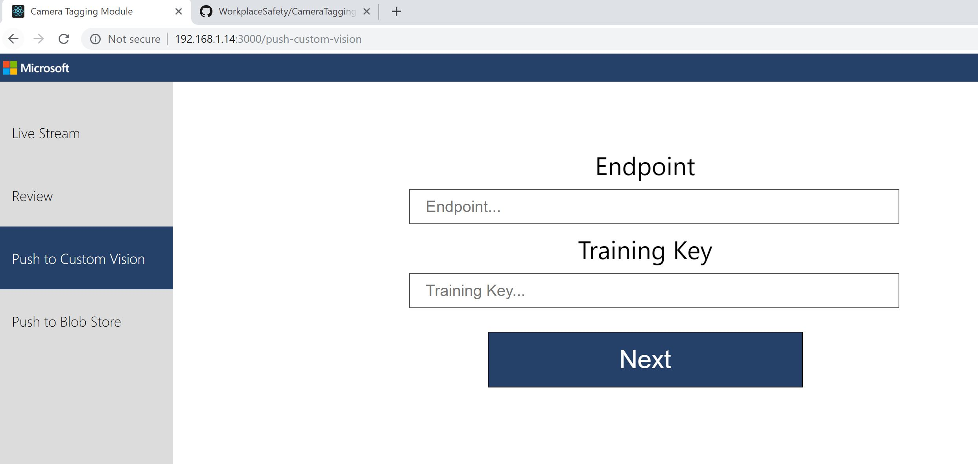
Camera Tagging Module

Slide 13
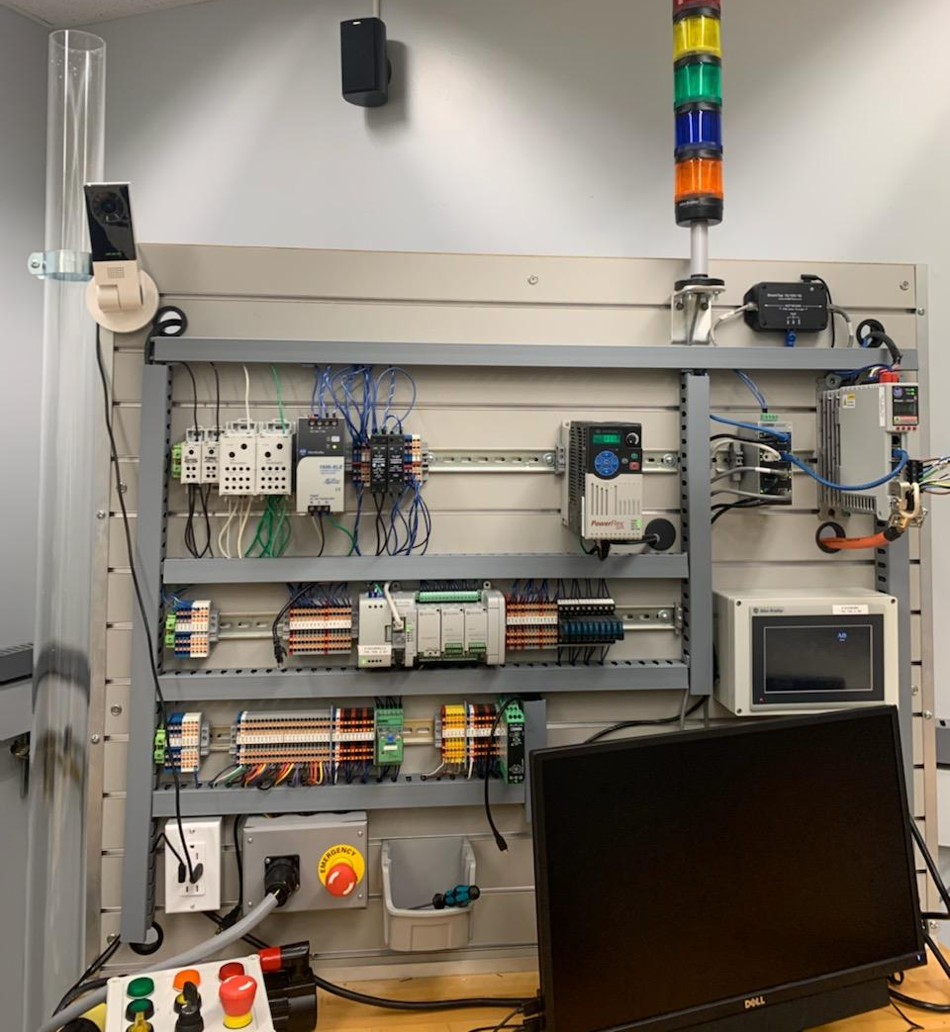
What’s Next
Purdue Engineering – Research on Safety Glass for MFG.
Rockwell Automation Deployment and Testing

Slide 14
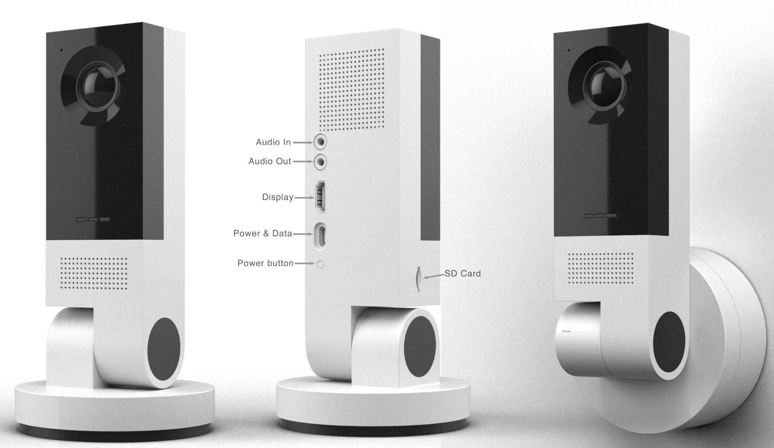
Why Vision AI Dev Kit?
High-speed and volume of Frame processing on edge, building machine learning models and IoT edge management are more essential than ever.
Vision AI Dev Kit
We need a way to run and demo trained models
Rasp Pi to run pretrained models on edge is very slow
Demonstrate Microsoft assets like Azure Machine Learning services, Azure IoT , Cognitive Services – Custom Vision
Build a community of Computer Vision Enthusiast that share and build on each other ideas . . . . . . .
Learn ML and AI build solution for ourselves and our partners that scales …

Slide 15
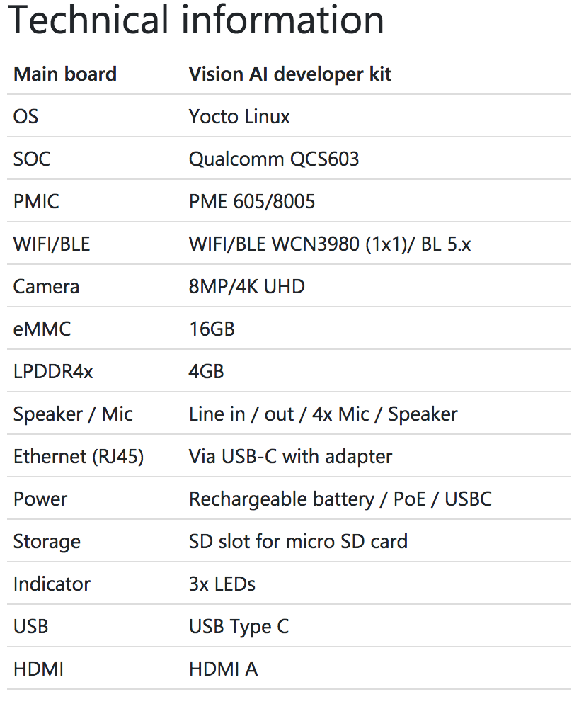
Vision AI Developer Kit Hardware Specification
Notes:
https://www.qualcomm.com/products/qcs603

